Slide 1

Movie Recommendation System
A Data-Driven Approach to Reducing Choice Paralysis and Improving User Engagement
In the competitive landscape of streaming services, simply offering a vast library of content is no longer enough. Users often find themselves overwhelmed by the sheer volume of choices, leading to frustration and a higher likelihood of churning. This presentation outlines our strategy to combat choice paralysis through a sophisticated movie recommendation system, aiming to boost user engagement, enhance satisfaction, and ultimately drive retention on our platform.

Slide 2
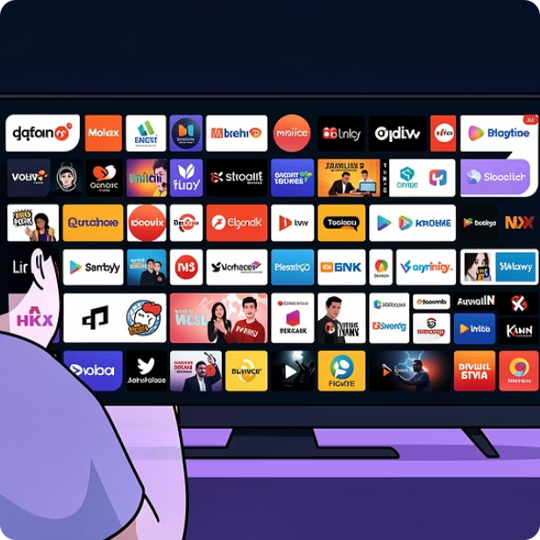
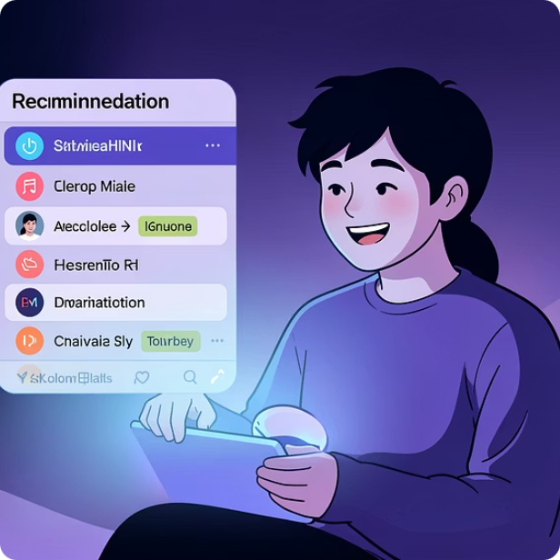
INTRODUCTION
Project Overview
This project aims to revolutionize content discovery on our streaming platform. By leveraging advanced data science techniques, we will move beyond generic suggestions to provide truly personalized movie recommendations. Our goal is to transform the user experience from endless scrolling to instant gratification, fostering a deeper connection with our service.
The Challenge: Choice Paralysis
The Solution: Personalized Discovery
Users are drowning in content. The paradox of choice dictates that while variety is appealing, too much can lead to anxiety and decision fatigue, often resulting in no choice at all.
A smart recommendation engine acts as a trusted curator, guiding users to content they'll love, thus enriching their viewing experience and saving valuable time.

Slide 3


THE PROBLEM
Background of the Problem
Modern streaming platforms, including our own, pride themselves on offering expansive libraries with thousands of titles spanning every genre imaginable. While this breadth of content is a core value proposition, it inadvertently creates a significant user experience challenge: choice paralysis. Instead of enhancing satisfaction, an overwhelming number of options often leads to frustration.
Thousands of Titles, Limited Time With an ever-growing catalog, users spend an inordinate amount of time browsing and deliberating rather than actually watching. This "search fatigue" detracts from the primary enjoyment of a streaming service.
Frustration and Poor Experience The inability to quickly find something enjoyable transforms what should be a relaxing activity into a tedious chore. This frustration directly impacts user satisfaction and engagement metrics.
Risk of Unsubscription A consistently poor content discovery experience erodes the perceived value of the subscription. When users feel they can't easily find content they love, they become more susceptible to churning to competitors that promise a more curated experience.

Slide 4
IMPACT ASSESSMENT
Business Problem: High Churn Rate Caused by Poor Content Discovery
The consequences of choice paralysis are not merely anecdotal; they translate directly into tangible business challenges, particularly a high churn rate. When users feel overwhelmed by options and struggle to find personalized content, their perceived value of our platform diminishes, leading to subscription cancellations.
Users Overwhelmed by Too Many Options
Lack of Personalization
Decreased Perceived Platform Value
Without intelligent recommendations, our platform's value proposition is diluted. Users perceive a generic, one-size-fits-all experience rather than a service tailored to their unique tastes and preferences, making them question the subscription fee.
The vast content library, while an asset, becomes a liability when users cannot navigate it effectively. The mental load of sifting through countless titles without clear guidance creates a negative user journey.
The direct result of frustration and lack of personalization is a reduced perception of the platform's overall value. This perception is a critical driver for subscription retention and willingness to recommend the service to others.
Addressing these issues is paramount for sustainable growth and competitive advantage in the streaming industry.

Slide 5
SOLUTION FOCUS
Project Goal: Increase User Engagement and Retention
Our overarching goal is to transform the user experience by implementing a highly effective movie recommendation system. This initiative is designed to directly address the business problems identified, leading to measurable improvements in key performance indicators.
Increase User Engagement
Boost User Retention
By providing relevant and timely recommendations, we aim to keep users actively interacting with the platform for longer durations, reducing idle browsing time and increasing content consumption.
A more satisfying and personalized experience translates directly into higher loyalty. Users who consistently find content they love are less likely to churn, securing long-term subscriptions.
Reduce Decision-Making Time for Users
Deliver Relevant Content Through Personalization
Our system will act as an intelligent filter, minimizing the cognitive load on users by presenting them with fewer, more relevant choices, allowing them to spend more time enjoying content.
Moving away from generic lists, the recommendation engine will leverage individual viewing habits and preferences to offer a truly tailored content discovery journey for each user.

Slide 6

FOUNDATION
Objectives & Data
To achieve our project goals, a clear set of technical objectives and a robust understanding of our available data are essential. This section details the specific aims of our recommendation engine and the datasets that will power its development.
Our approach is rooted in a data-driven methodology, ensuring that every recommendation is backed by empirical evidence of user behavior and content characteristics.

Slide 7
TECHNICAL ROADMAP
Project Objectives
To successfully implement our movie recommendation system, we have defined two primary technical objectives that will guide our development and evaluation processes. These objectives focus on building a robust collaborative filtering engine capable of accurate predictions and delivering actionable, personalized recommendations.
1
2
3
Build a Collaborative Filtering Recommendation Engine
Predict User Ratings for Unseen Movies
Generate a Personalized Top-5 Recommendation List for Each User
The core of our solution will be a collaborative filtering algorithm. This approach leverages the wisdom of the crowd, identifying users with similar tastes or items with similar appeal to generate recommendations. We will explore various collaborative filtering techniques, such as user-based and item-based methods, to determine the most effective model for our dataset.
A critical function of our engine will be its ability to accurately predict how a user would rate a movie they haven't yet seen. This predictive capability is fundamental to identifying content that aligns with individual preferences and goes beyond simple popularity metrics.
The ultimate output of our system will be a concise, personalized list of the top 5 most relevant movie recommendations for every user. This focused list aims to minimize choice paralysis while maximizing the likelihood of discovery and consumption, directly impacting user engagement and satisfaction.

Slide 8

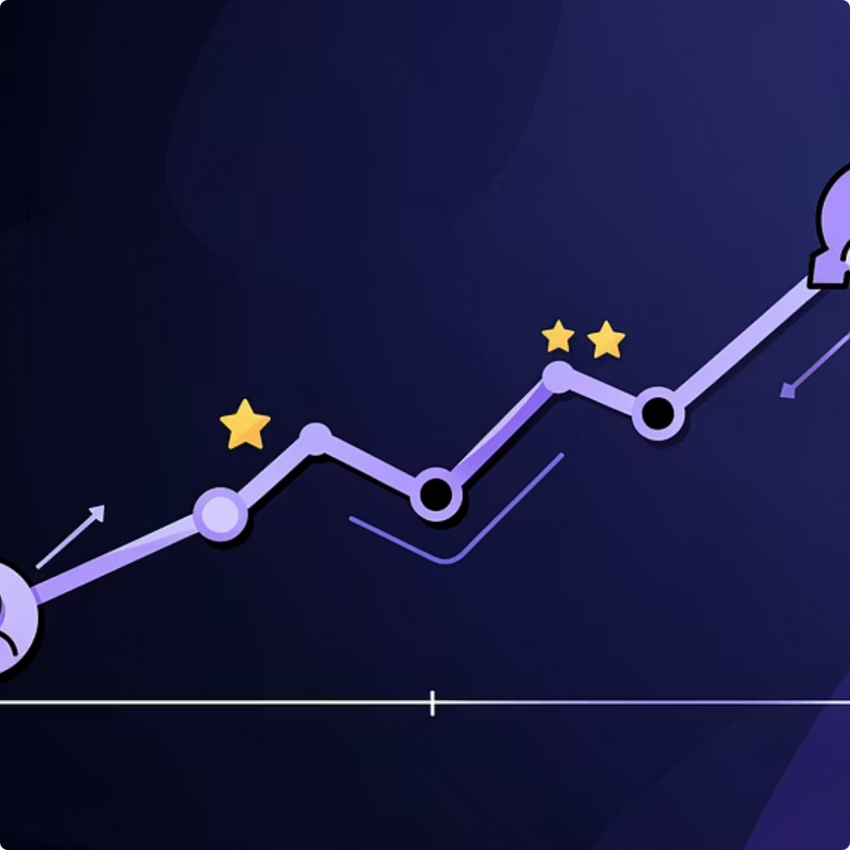
DATA ASSET
Dataset Description
The foundation of any robust recommendation system lies in the quality and structure of its data. For this project, we will primarily utilize two interconnected datasets, carefully designed to capture the essence of user-item interactions and content characteristics.
Movies Dataset
Ratings Dataset
This dataset serves as our content catalog, containing essential metadata for each film available on the platform. Key attributes include:
This dataset captures the explicit feedback from our users, providing direct insights into their preferences and interactions with content. It includes:
Movie Titles: The official name of each film.
Genres: Categorical classifications (e.g., Action, Comedy, Drama, Sci-Fi) which are crucial for content-based analysis and understanding user preferences.
Additional Metadata: (Potentially) Release year, director, cast, and plot summaries, which can further enrich our recommendation capabilities in advanced stages.
User ID: Unique identifiers for each individual user.
Movie ID: Links to the corresponding movie in the 'Movies Dataset'.
Rating: The numerical score (e.g., 1-5 stars) a user assigned to a movie.
Timestamp: The date and time when the rating was provided, allowing for temporal analysis and understanding evolving user tastes.
This structure is ideal for building user-item interaction matrices, which are fundamental for collaborative filtering.

Slide 9

INSIGHTS
Exploratory Data Analysis (EDA)
Before diving into model building, a thorough Exploratory Data Analysis (EDA) was conducted to understand the underlying patterns, distributions, and characteristics of our datasets. This phase is crucial for informing modeling choices, identifying potential data quality issues, and gaining initial insights into user behavior and content popularity.
Ratings
User Activity
Top Movies
Analyzed Distribution of Movie Ratings We examined the frequency of different rating scores (e.g., how many 5-star ratings versus 1-star ratings). This revealed common rating biases and the overall sentiment towards content. A skewed distribution could indicate either a highly satisfied user base or a tendency for users to only rate movies they strongly like or dislike.
Examined User Activity and Rating Frequency This involved analyzing how frequently users submit ratings and the total number of movies each user has rated. We identified 'cold start' users with few ratings and 'power users' with extensive rating histories. Understanding user activity patterns is vital for handling sparsity in collaborative filtering models.
Identified Popular Movies and Active Users By aggregating ratings, we identified movies that received a large number of high ratings, indicating their popularity. Similarly, we pinpointed the most active users who contribute significantly to the dataset. These insights help in understanding content trends and potential influential users.
EDA provides a solid empirical foundation, ensuring our modeling efforts are grounded in the realities of our data.

Slide 10
STRATEGY
Modeling Approach
Our modeling approach will focus on leveraging collaborative filtering techniques, which have proven highly effective in recommendation systems due to their ability to capture subtle user preferences and item similarities. We will explore both memory-based and model-based methods to identify the most robust and performant solution for our platform.
Collaborative Filtering Algorithms
Data Preprocessing and Feature Engineering
We plan to experiment with several collaborative filtering algorithms:
Before model training, raw data will undergo rigorous cleaning, normalization, and transformation. This includes handling missing values, encoding categorical features (like genres), and constructing user-item interaction matrices. We will also explore implicit feedback signals beyond explicit ratings, such as watch duration or click-through rates, as potential features.
User-Based CF: Recommending items liked by similar users.
Item-Based CF: Recommending items similar to those a user has liked.
Matrix Factorization (e.g., SVD, FunkSVD): Decomposing the user-item interaction matrix into lower-dimensional latent factor matrices to uncover hidden preferences.
Deployment and A/B Testing
Model Evaluation and Validation
Once a robust model is identified, it will be prepared for deployment. A/B testing will be conducted to compare the performance of the new recommendation system against our current approach (or a baseline model) in a live environment, measuring impact on key business metrics like engagement, retention, and time-to-decision.
Model performance will be rigorously evaluated using metrics such as RMSE (Root Mean Squared Error) for rating prediction accuracy and precision/recall@k for the quality of top-N recommendations. Cross-validation techniques will be employed to ensure the model's generalization capabilities, preventing overfitting.

Slide 11

RECOMMENDATIONS
Next Steps & Future Outlook
Deploy SVD Model
Continuous Model Retraining
Monitor Engagement Metrics
Implement the Singular Value Decomposition (SVD) model as the primary recommendation engine for its superior predictive performance.
Ensure recommendation relevance by periodically retraining the model with new user data, adapting to evolving preferences.
Track key performance indicators like watch time, click-through rate, and retention to assess real-world impact and guide optimization.
Personalized Top-5 Interface
Incorporate Hybrid Techniques
Introduce a concise "Top-5 Recommended for You" section to reduce choice paralysis and guide users to relevant content.
Mitigate cold-start issues by combining collaborative filtering with content-based approaches, using movie metadata.
Conclusion
This project successfully addressed choice paralysis by developing a personalized movie recommendation system using collaborative filtering, particularly Singular Value Decomposition (SVD). The system effectively learned user preferences from historical rating data, generating accurate predictions for unseen movies.
The results demonstrate that data-driven recommendation systems significantly enhance content discovery by reducing browsing time and improving user satisfaction. Presenting users with a curated Top-5 list streamlines decision-making and encourages active content consumption.
While the system shows strong performance, challenges like the cold-start problem and data sparsity remain. These limitations highlight future opportunities for improvement through hybrid recommendation models and the integration of additional user and content features.
Overall, this study confirms that personalized recommendation systems are an effective strategy for improving user engagement and retention in digital streaming services, playing a critical role in enhancing the overall user experience.

